Slide 1

Note: The data and information in this document is reflective of a hypothetical situation and client. This document is to be used for KPMG Virtual Internship purposes only.
Sprocket Central Pty Ltd
Data analytics approach
Olushola Peters

Slide 2
Note: The data and information in this document is reflective of a hypothetical situation and client. This document is to be used for KPMG Virtual Internship purposes only.
Agenda
Introduction
Data Exploration
Model Development
Interpretation

Slide 3
Note: The data and information in this document is reflective of a hypothetical situation and client. This document is to be used for KPMG Virtual Internship purposes only.
Introduction
Business Case
A predictive analysis on 1000 new customers data based on previous customer and transaction data to reveal useful customer insights which could help optimize resource allocation for targeted marketing. Hence, improve performance by focusing on high value customers.
Client
Sprocket Central PTY Ltd

Slide 4
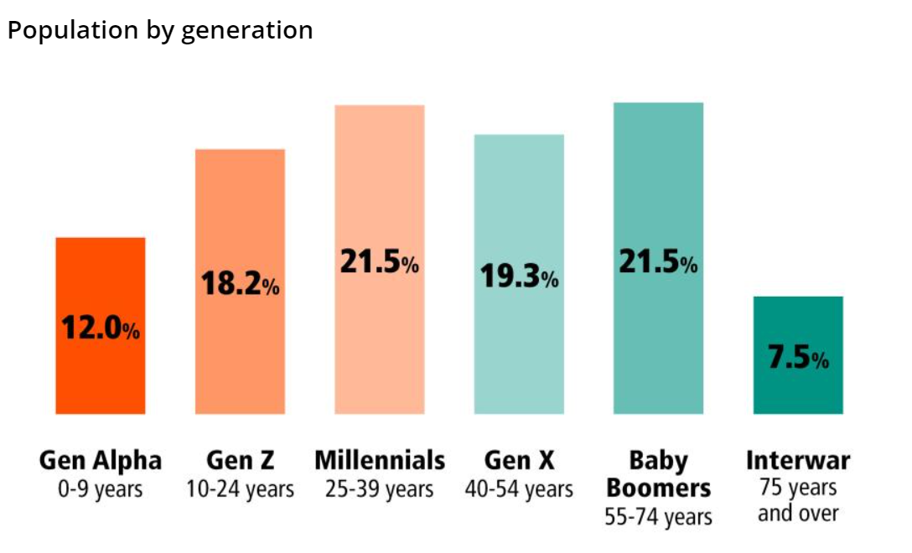
Note: The data and information in this document is reflective of a hypothetical situation and client. This document is to be used for KPMG Virtual Internship purposes only.
Data Exploration
To predict the remaining customer base, it is crucial to understand the characteristics of the underlying data, such as variable distributions and demographic skewedness. Identify limitations and gather external data for modeling purposes, such as ABS data at different geographic levels. Investigate interactions between variables through correlation analysis and multicollinearity by creating interaction variables. Transform the required data into an appropriate format for analysis, ensuring data types are appropriate and rolling up to an aggregated level. Document assumptions, limitations, and exclusions for the data and plan for improvement in the next stage.
Example for Demographic Classification using ABS

Slide 5
Note: The data and information in this document is reflective of a hypothetical situation and client. This document is to be used for KPMG Virtual Internship purposes only.
Model Development
We will determine a hypothesis related to the business question that can be answered with the data.
Perform the necessary data cleaning, wrangling, and joins to make that data fit for analysis.
Perform statistical testing to determine if the hypothesis is valid or not. Create calculated fields based on existing data.
Test the performance of the model using factors relevant to the given model chosen (i.e., residual deviance, AIC, ROC curves, and R squared).
Appropriately document model performance, assumptions, and limitations.

Slide 6
Note: The data and information in this document is reflective of a hypothetical situation and client. This document is to be used for KPMG Virtual Internship purposes only.
Interpretation and Reporting
Visualization and presentation of findings This may involve interpreting the significant variables and coefficients from a business perspective. These slides should tell a compelling story around the business issue and support our case with quantitative and qualitative observations.

